Slide 1
Digital Portfolio
STUDENT NAME: VIKNESH R
REGISTER NO AND NMID: asbru092422k2277
DEPARTMENT: Bsc.Computer Science
COLLEGE: COLLEGE/ UNIVERSITY GOVT ARTS COLLEGE UDUMALPET , BHARATHIYAR UNIVER

Slide 2
PROJECT TITLE
Interactive po:folio using
Front end Web development

Slide 3


AGENDA
Problem Statement
Project Overview
End Users
Tools and Technologies
Portfolio design and Layout
Features and Functionality
Results and Screenshots
Conclusion
Github Link
3/21/2024 Annual Review

Slide 4

PROBLEM STATEMENT
“How can I create a simple, modern, and responsive personal portfolio website that works well on both desktop and mobile, and lets me showcase my skills, hobbies, projects, and contact details?”
HTML → structure & content
CSS → design & responsiveness
JS → interaction

Slide 5

PROJECT OVERVIEW
This project is about creating a personal portfolio website for Viknesh.The website shows introduction, skills, hobbies, projects, and contact details in clean and modern design.It is responsive, meaning it works well on both mobile and desktop devices. The site also has an interactive navigation menu.
The goal is to provide an online space where Viknesh can showcase his creativity, coding skills, and artwork, while also giving others a simple way to contact him.

Slide 6

WHO ARE THE END USERS?
1. Teachers & Professors – review Viknesh’s projects and creativity
2. Future Employers / Recruiters – check his abilities, projects, and contact details
3. Friends & Classmates – explore hobbies, drawings, writings
4. General Visitors – know about Viknesh’s talents and contact him

Slide 7

TOOLS AND TECHNIQUES
Tools:
•HTML5 → Structure
•CSS3 → Layout & Responsiveness
•JavaScript → Interactivity
•VS Code → Coding
•Browser (Chrome/Edge/Firefox) → Testing
Techniques:
•Responsive Web Design
•Flexbox & Grid
•Sticky Navbar & Hamburger Menu
•Form Handling
•Hover Effects & Transitions

Slide 8
POTFOLIO DESIGN AND LAYOUT
•Navbar: Sticky (hamburger on mobile) •Home: Welcoming banner with Viknesh’s name & gradient background •About: Skills & hobbies list •Projects: Responsive grid, card layout •Contact: Phone, email, education, contact form •Footer: Copyright + creative
8

Slide 9
FEATURES AND FUNCTIONALITY
1. Responsive Design 2. Sticky Navigation Bar 3. Home Section – Viknesh’s intro 4. About Section – Skills, hobbies, interests 5. Projects Section – Card layout 6. Contact Section – Phone, email, form 7. Interactive UI – Hover effects, transitions 8. Footer Section

Slide 10
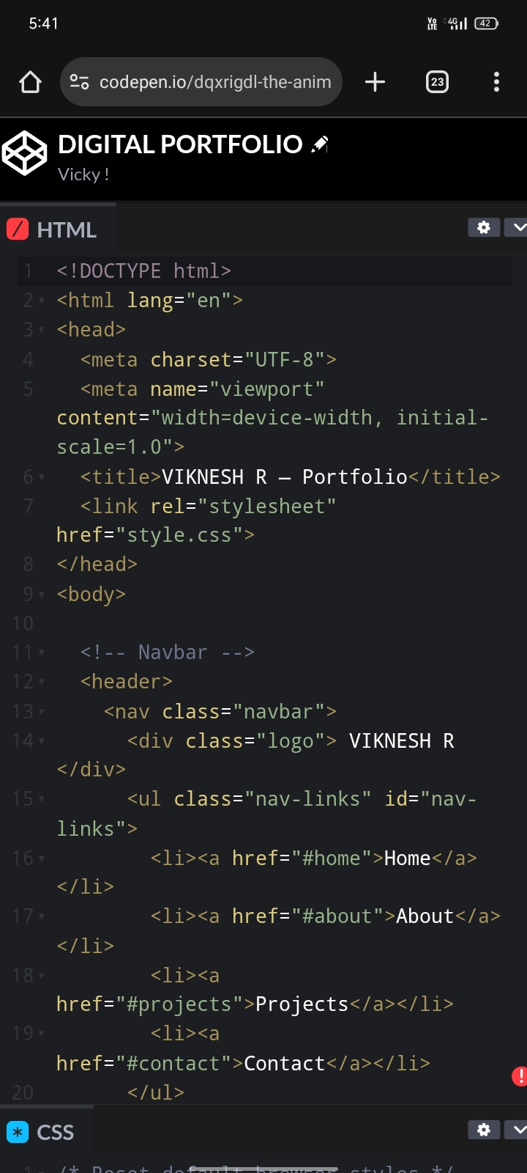
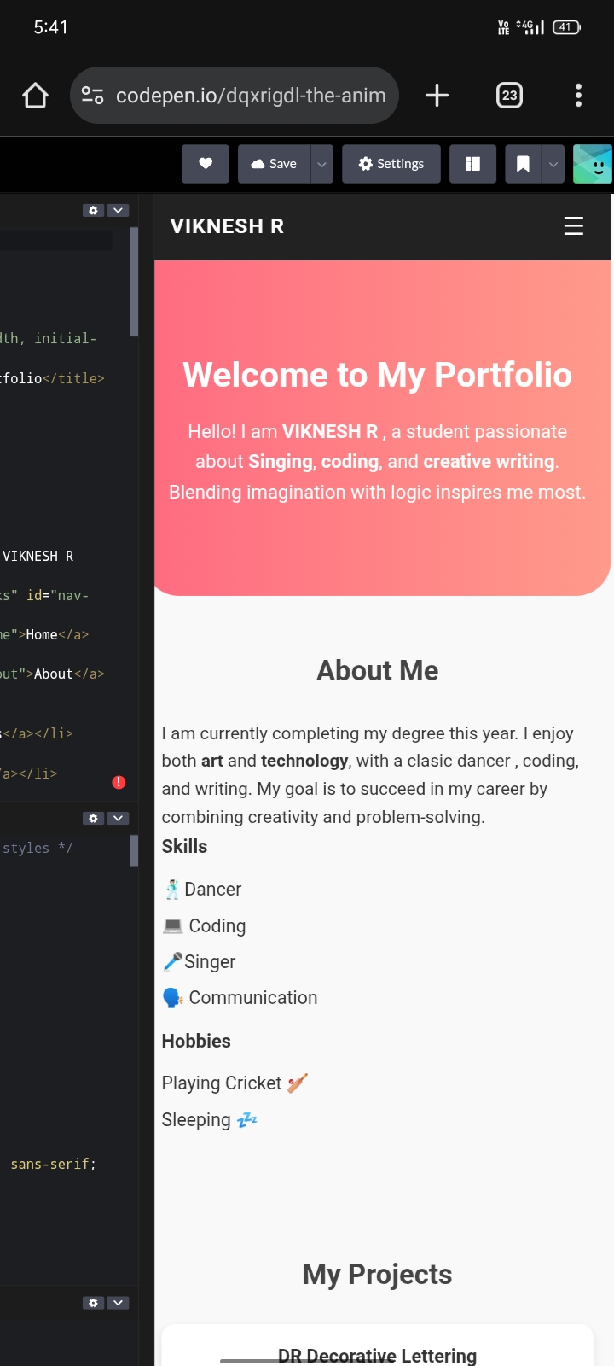

RESULTS AND SCREENSHOTS
3/21/2024 Annual Review
10

Slide 11
CONCLUSION
The personal portfolio website is a responsive, creative, and user-friendly platform that showcases Viknesh’s skills, hobbies, and projects. By combining HTML, CSS, and JavaScript, it ensures smooth navigation and interactivity. This project merges creativity and technology, helping Viknesh present his work to teachers, friends, and employers – making it a valuable step toward his career and growth
11

